Slide 1
AP® PHYSICS 1
WITH GREENMAN AND DUFFY
Project Accelerate – edX AP® Physics 1
Bringing AP® Physics to Underserved Student Populations
Project Team
Mark D. Greenman, Research Fellow Physics Department
Andrew Duffy, Master Lecturer Physics Department
Digital Learning Group
Boston University
Mark D. Greenman - Project Director
greenman@bu.edu

Slide 2
AP® PHYSICS 1
WITH GREENMAN AND DUFFY
Project Accelerate – edX AP® Physics 1
Presentation Outline
The Problem
A Scalable Solution
Research Measures
Outcomes - Year 1 Pilot Project
Scaling Up and Replicating
Vision for the Future

Slide 3
AP® PHYSICS 1
WITH GREENMAN AND DUFFY
Project Accelerate – edX AP® Physics 1
I. The Problem
STEM Workforce and Diversity
Lacking opportunity to access rigorous physics courses in HS economically disadvantaged and underrepresented groups are hard pressed to compete in STEM fields and academic programs with their peers from more affluent communities.
Notes:
There are thousands of schools and tens of thousands of students who do not have access to AP Physics. This is a result of a host of reasons from lack of trained faculty, small numbers of interested students, prohibitive costs especially for low income districts to provide such a course for small numbers of interested students, etc.
Bottom Line: Such students, lacking opportunity, are hard pressed to compete with their peers at university.

Slide 4
AP® PHYSICS 1
WITH GREENMAN AND DUFFY
Project Accelerate – edX AP® Physics 1
A Specific Example
Boston Public School
Serves 53,000 students w. 34 high schools serving 16,200 students.
75% African American and Hispanic (27% state).
General Group Description | Specific Group Description | No. of Students | % Score 1 & 2 | % Score 3, 4 & 5
AP® Physics 1 Students Not Enrolled in Project Accelerate | Nation (white) | 83,702 | 54 | 46
 | Nation (black and Hispanic) | 39,402 | 84 | 16
 | Massachusetts PS (non BPS) | 3,398 | 57 | 43
 | Boston PS (non Project Accelerate) | 151 | 92 | 8
Table 1: Outcomes – Massachusetts’ data obtained from mass.gov 2016 Department of Elementary and Secondary School website. National data from College Board, 2016.
Notes:
BPS provide neither widespread access to AP® Physics, nor the structure required to produce broad academic success.
Students from urban schools, rural poor schools and small suburban schools are all too often not offered the opportunity to participate in this all too often gate keeper course to engineering, computer science, physics and many medical related fields.

Slide 5
AP® PHYSICS 1
WITH GREENMAN AND DUFFY
Project Accelerate – edX AP® Physics 1
II. A Scalable Solution
Closing the Learning Gap
A National Problem and a Potential Solution: Project Accelerate is a National Science Foundation funded partnership program between Boston University and individual high schools. Project Accelerate combines the supportive infrastructures from the students’ traditional school with a highly interactive private edX online instructional tool to bring AP® Physics 1 to schools not offering AP® Physics.
Notes:
Program: Partnership between high schools that do not offer AP Physics as part of regular program of study, university and edX online provider. No more than 9 students are accepted into the program per high school. Course blends together the supportive infrastructure of the student’s home school with a private edX online course designed specifically with high school students in mind. The online program is short on “video professor” and long on providing engaging instruction providing multiple student controlled simulations and direct video laboratory experience in each module. Online as well as the option of hands-on laboratories are introduced through a research question and all components of instruction model “habits of mind” thinking and practices associated with STEM.
CB Accredited: There are two varieties both offer students a good opportunity to achieve a 3 or better on the CB AP Physics 1 test. A CB Accredited Course requiring hands-on laboratory and a non- accredited AP Physics 1 Prep. course. Students who are within commuting distance to the university campus participate in a once-a-week 2.5 hour laboratory session facilitated by trained undergraduate physics majors (undergraduate TAs) under the supervision of the university liaison. Each laboratory begins with a research question. Students develop a draft report responding to the research question and then a final report including the research question, response to research question and most cogent data and analysis in support of claim about research question. University liaison keeps portfolio of draft reports and students keep portfolio of final reports.
Community of Learners - Online: The online program includes a built-in online forum where students engage in discourse, pose questions and provide help to other students who form this community of physics learners. The forum is monitored by the university liaison and the undergraduate Teaching Assistants.

Slide 6
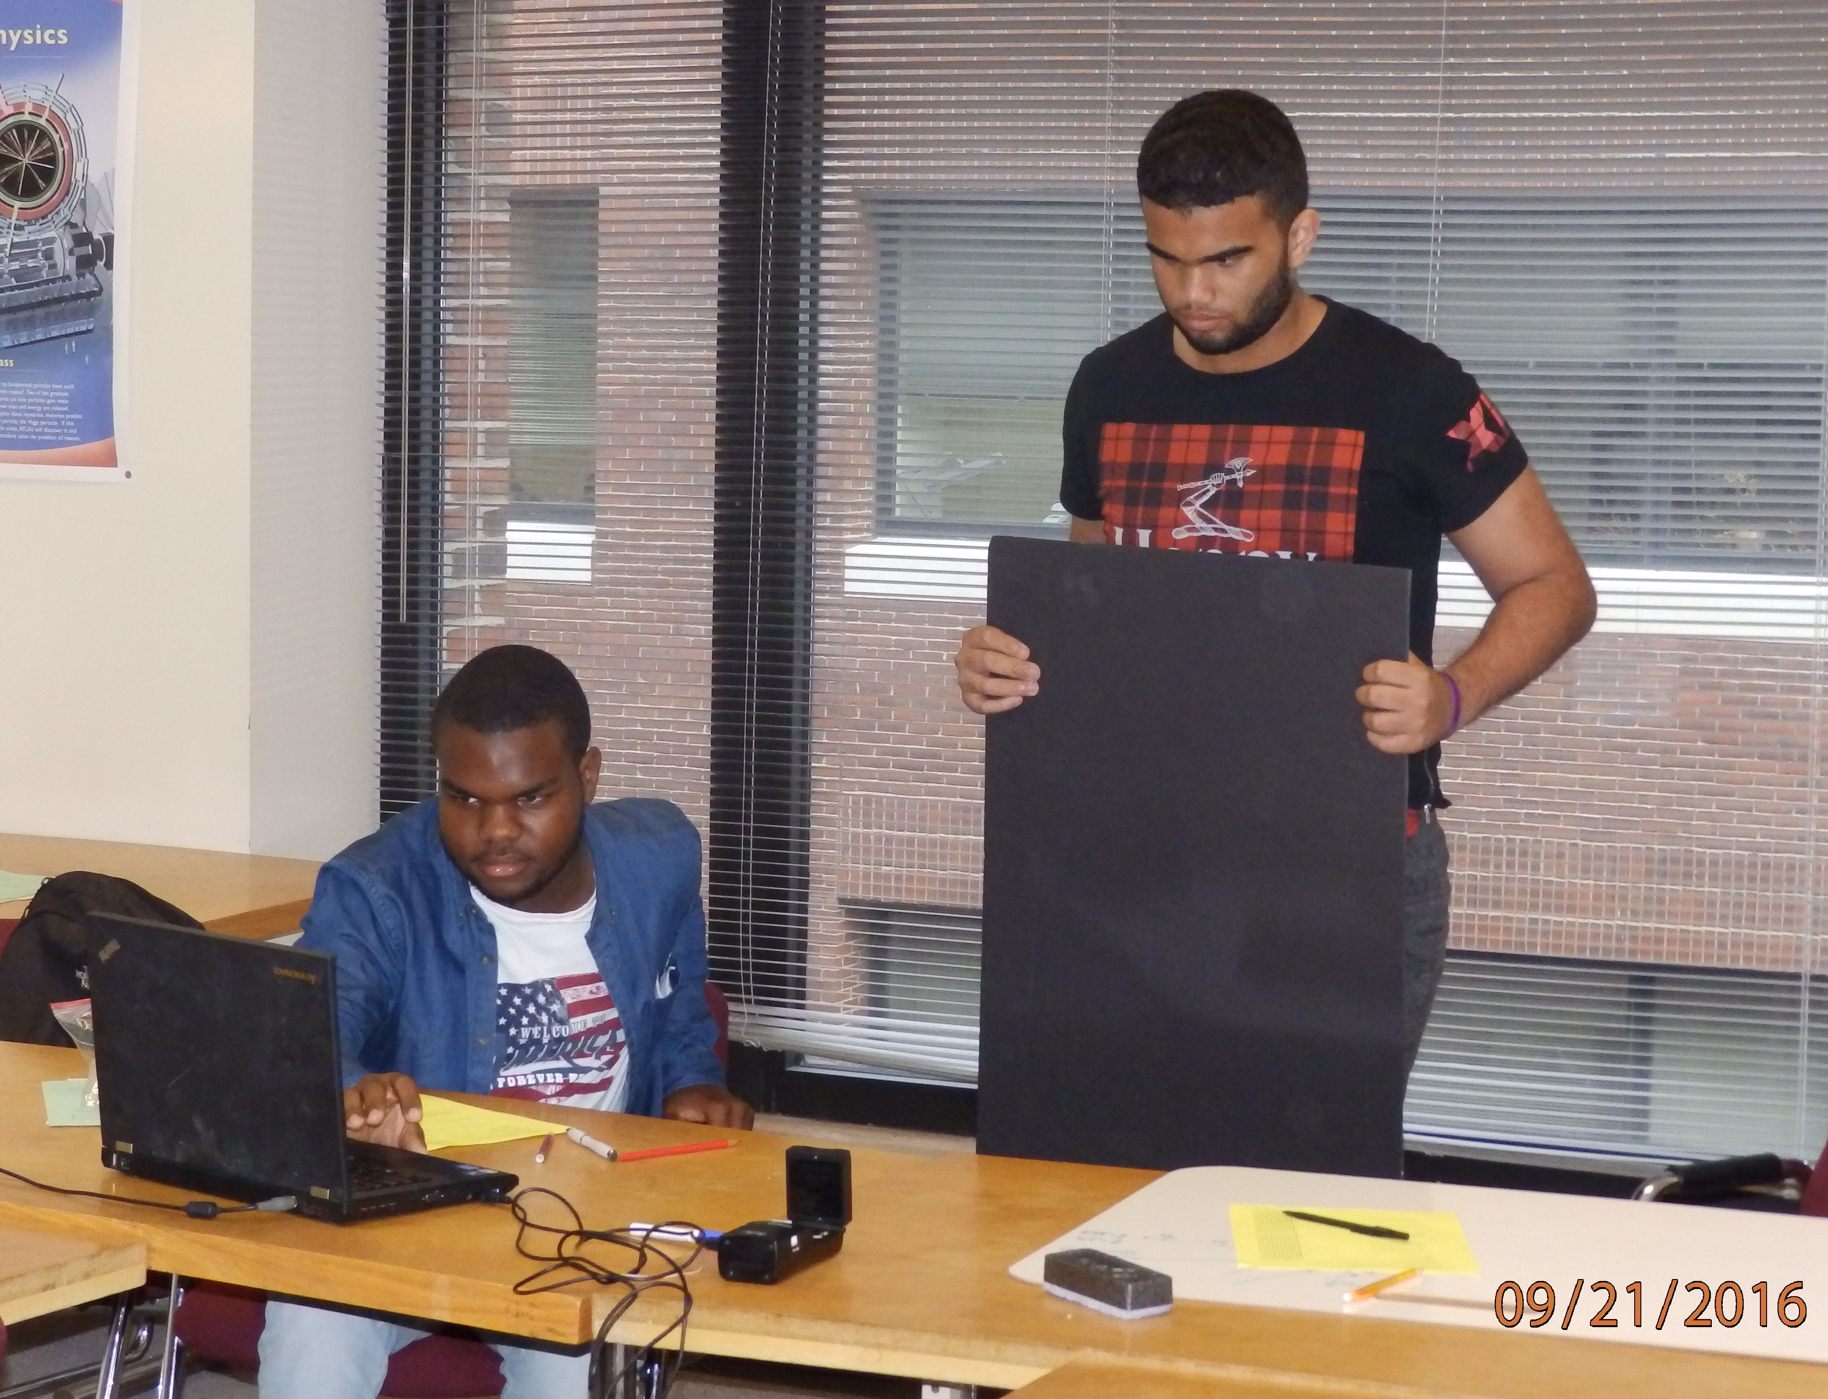
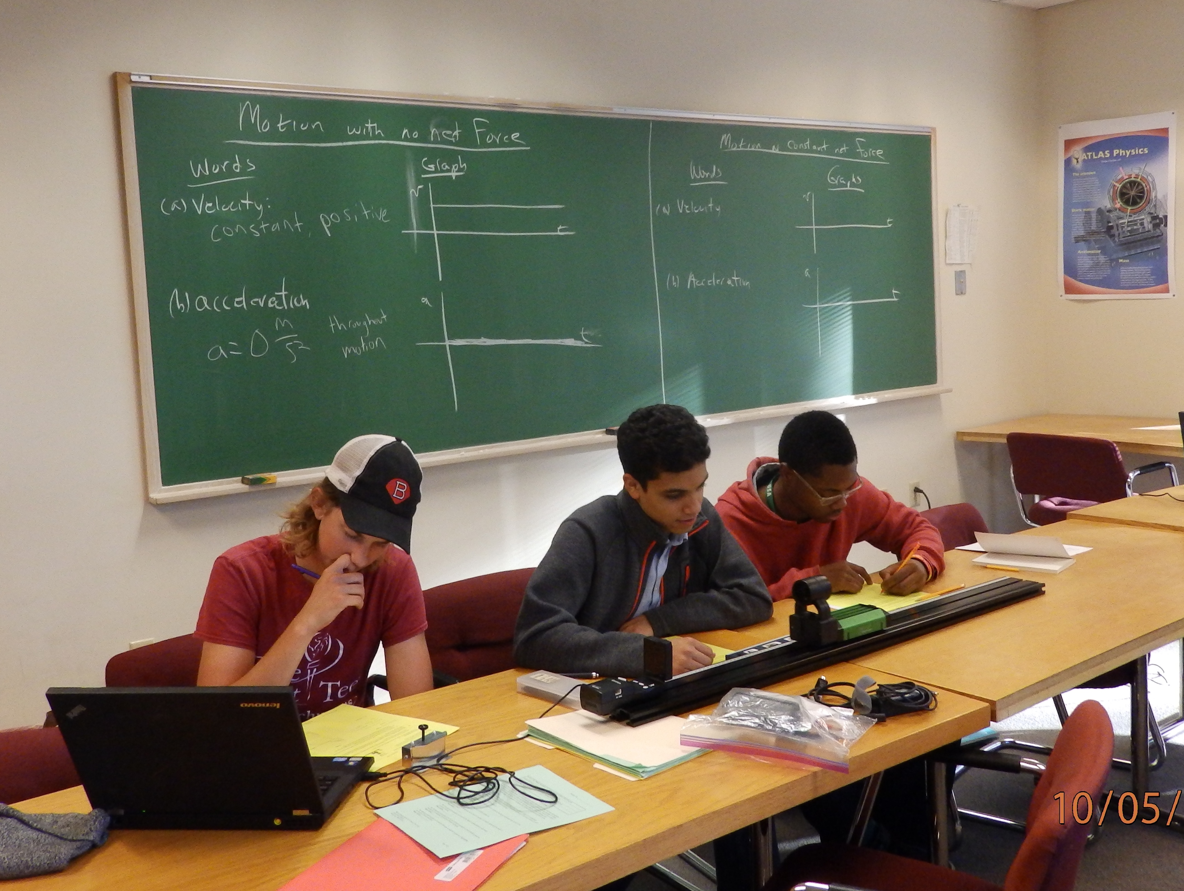
AP® PHYSICS 1
WITH GREENMAN AND DUFFY
Project Accelerate – edX AP® Physics 1
II. A Scalable Solution
Four Components to Project Accelerate
Interactive edX Small Private Online Course.
High School Partner (liaison, in school schedule, etc.).
University Partner (liaison, progress reports, etc.)
Optional Hands-on Laboratory Component.
Notes:
Online Component: Interactive and engaging authored specifically to work seamlessly with a typical high school schedule. There are 28 graded virtual laboratories, 28 graded HW assignments, 24 graded quizzes and 8 graded, proctored and timed simulated AP style tests. The virtual laboratories as well as instructional explorations are taken woven throughout the course and come from Direct Measurement Video by Peter Bohacek, PhETs from University of Colorado and interactive simulations by Andrew Duffy co-author of Project Accelerate.
HS Partnership: As important is the role played by the HS partner. The HS appoints a professional staff member to serve as “HS liaison.” The liaison facilitates communication between the school, students and the project team. The HS vets and assigns participating students in school time like any other major course, includes the course in the student’s transcript and report card. The facilitator is the chief encourager and nagger keeping students on task and on schedule.
University Partner: The Project team appoints a University liaison who among other things communicates regularly with the HS liaison concerning student progress, student midterm reports and student end of term grades. The University liaison monitors the course online forum and where applicable supervises undergraduate teacher assistants who facilitate the on-campus hands-on laboratory component of the courses.
Optional Hands-on Component: All students within commuting distance of the BU campus participate in a 2 and ½ hour small group weekly laboratory and recitation session. We encourage and wherever possible support schools providing a HS site hands-on laboratory component to complement the online instruction tools.
CB Accredited: There are two varieties both offer students a good opportunity to achieve a 3 or better on the CB AP Physics 1 test. A CB Accredited Course requiring hands-on laboratory and a non- accredited AP Physics 1 Prep. course. Students who are within commuting distance to the university campus participate in a once-a-week 2.5 hour laboratory session facilitated by trained undergraduate physics majors (undergraduate TAs) under the supervision of the university liaison. Each laboratory begins with a research question. Students develop a draft report responding to the research question and then a final report including the research question, response to research question and most cogent data and analysis in support of claim about research question. University liaison keeps portfolio of draft reports and students keep portfolio of final reports.

Slide 7
AP® PHYSICS 1
WITH GREENMAN AND DUFFY
Project Accelerate – edX AP® Physics 1
III. Research
Measures of Effectiveness of Program
College Board AP Physics 1 Test.
Force and Motion Conceptual Evaluation.
Student Course Performance.
Retention and Attendance.
Student End of Year Survey.
Impact on Student Choices and Success in STEM.
Scalability of Program
Ability to Replicate at Other Sites.
Notes:
Effectiveness of the Program: We are looking at the efficacy of the model. We explore student outcomes in terms of AP® exam performance, standardized content (FMCE), course performance, standardized attitudinal (EBAPS) measures, course completion, attendance at laboratory sessions, survey responses and longitudinal college acceptance, STEM course performance, and retention.
Scalability: We additionally explore the structure of the blended model and university to school partnership both in the local pilot program, and in terms of whether it can be replicated at other sites around the country.

Slide 8
AP® PHYSICS 1
WITH GREENMAN AND DUFFY
Project Accelerate – edX AP® Physics 1
Pilot Year 1 - AP Exam Scores
Although the sample size was too small to provide statistical significance, preliminary results are very promising. Project Accelerate students outperformed their peer groups enrolled in traditional AP Physics 1 classrooms.
General Group Description | Specific Group Description | No. of Students | % Score 1 & 2 | % Score 3, 4 & 5
AP® Physics 1 Students Not Enrolled in Project Accelerate | Nation (white) | 83,702 | 54 | 46
 | Nation (black and Hispanic) | 39,402 | 84 | 16
 | Massachusetts PS (non BPS) | 3,398 | 57 | 43
 | Boston PS (non Project Accelerate) | 151 | 92 | 8
AP® Physics 1 Students Enrolled in Project Accelerate | Massachusetts PS (non BPS) | 7 | 29 | 71
 | Boston PS | 14 | 86 | 14
Table 1: Outcomes – Massachusetts’ data obtained from mass.gov 2016 Department of Elementary and Secondary School website. National data from College Board, 2016.
Notes:
!00% of students participating in Project Accelerate take the College Board AP Physics test in May.
Our Boston Public School (BPS) participants did as well as BPS students attending schools offering a traditional AP Physics 1 classes.
Other participants outperformed the aggregate peer group of Massachusetts schools offering traditional AP Physics 1 classes.

Slide 9
AP® PHYSICS 1
WITH GREENMAN AND DUFFY
Project Accelerate – edX AP® Physics 1
IV. Pilot Year 1
Course Performance
FMCE .53 (paired fractional gain)
GPA 3.1 out of 4.0
Retention & Attendance
88% Completed the Course.
90% Attendance Rate at Laboratory Sessions.
Interest in STEM (Survey Results)
8 of 14 Participated in a Summer STEM Program with 75% Indicating the Course was Either Very Important or Somewhat Important in Decision.
52% Much More Likely or Somewhat More Likely to Pursue STEM.
Notes:
Student Performance: The pre/posttest paired fractional gain on the Force Motion Concept Evaluation (FMCE) was .53. The ave. GPA for the 21 completers was 3.1 out of 4.0.
Retention: Twenty-one of the initial 24 students completed the course resulting in an 88% retention rate.
Attendance: BPS students attended a weekly 2+ hour recitation block from 4PM to 6:30PM on the BU campus. The attendance rate at these sessions for the full year was 90%.
Interest in STEM: Eight of our 14 BPS completers applied to summer STEM programs. Of these 8, seventy-five percent indicated in our post-course survey that Project Accelerate was “very important” or “somewhat important” in their decision to apply to a summer STEM program. Fifty-two percent of all participating students indicated that they were either “much more likely” or “somewhat more likely” to pursue a STEM program in college as a result of participating in this program. The remaining 48% of students indicated “no impact on their decision.”

Slide 10
AP® PHYSICS 1
WITH GREENMAN AND DUFFY
Project Accelerate – edX AP® Physics 1
V. Scaling Up and Replication Sites
School Designation | Year 1: 2015-16 |  | Year 2: 2016-17 |  | ⁽²⁾Year 3: 2017-18
 | No. of Schools | No. of Students | No. of Schools | No. of Students | No. of Schools | No. of Students
Boston Public Schools | 4 | 17 | 5 | 25 | 7 | 24
Other: MA | 2 | 7 | 4 | 22 | 5 | 25
⁽¹⁾Other: Replication | 0 | 0 | 1 | 5 | 3 | 18
Totals | 6 | 24 | 10 | 52 | 15 | 67
Replication Site: West Virginia University (WVU) physics department (Gay Stewart) is our our first replication site.
Year 3: These are target numbers for 2017-18.
Notes:
Numbers of Schools and Students: Significantly increased numbers of schools and students in year 2 with likelihood of similar increases in year 3.
Replication Sites: We are partnering with Gay Steward of the West Virginia University physics department to bring this HS-University partnership program to schools in West Virginia. We have two schools with 13 students participating from WV. These schools have provided a HS liaison who meet with the students 2x a week to provide a hands-on laboratory component to the online component.

Slide 11
AP® PHYSICS 1
WITH GREENMAN AND DUFFY
Project Accelerate – edX AP® Physics 1
VI. Vision for the Future
Vision for Program: Project Accelerate offers a potential solution to a significant national and international problem of too few underserved young people having access to high quality physics education, resulting in these students being ill prepared to enter STEM careers and STEM programs in college.
Project Accelerate is a scalable model of STEM success, replicable at sites across the country and world, and therefore setting up for success thousands of motivated but underserved students every year.
Notes:
Goals: Our goals are (1) to gather evidence looking at the efficacy of Project Accelerate to deliver a successful AP Physics 1 experience to students from schools that do not offer AP Physics as part of the school’s program of study, (2) to gather evidence looking at the feasibility of scaling Project Accelerate to a national program, (3) to develop procedures and protocols to facilitate the successful and faithful replication of program delivery by other universities, and (4) to investigate infrastructures, procedures and protocols that would allow Project Accelerate to be sustainable at a cost of no more than $500 on average per participating student.

Slide 12
AP® PHYSICS 1
WITH GREENMAN AND DUFFY
Project Accelerate – edX AP® Physics 1
If interested in becoming a partner high school, a university replication site, or just to learn more about the program, contact either myself or Andrew Duffy
Mark D. Greenman
greenma@bu.edu
Andrew Duffy
aduffy@bu.edu

